Slide 1
ATTENDANCE CHAT BOX WITH AI
PRESENTED BY:- NETI VENKAT KUMAR
Course Name –
AI/ML INTERNSHIP PROJECT – EDUNET FOUNDATION
College Name – BEST GROUP OF INSTITUTIONS, TADEPALLIGUDEM

Slide 2
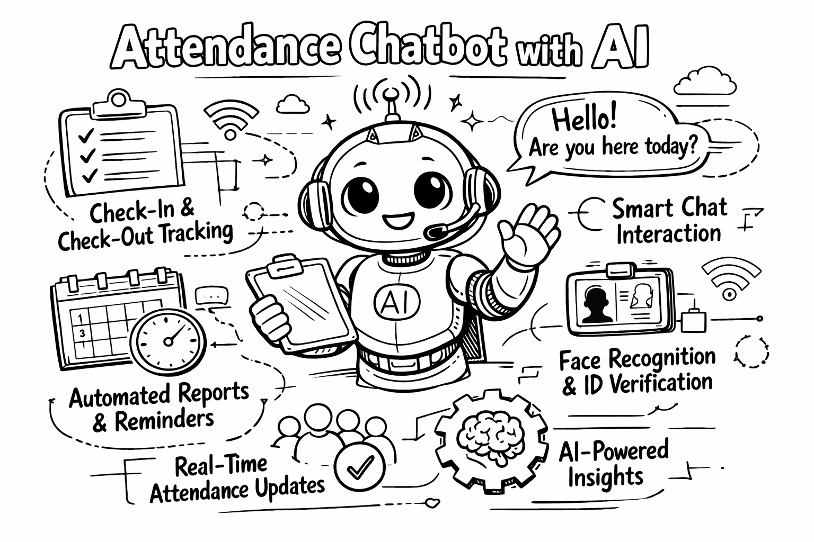
OUTLINE
Defined User Personas
Multi-Platform Integration
Identity Verification (AI Authentication)
Geofencing and Location Intelligence
Natural Language Processing (NLP)
Intent Classification
Automated Reminders and Nudges
Anomaly Detection
Leave Management Integration
Real-time Dashboard and Reporting
Offline Mode Support
Integration with Existing HRIS/LMS
Integration with Existing HRIS/LMS

Slide 3
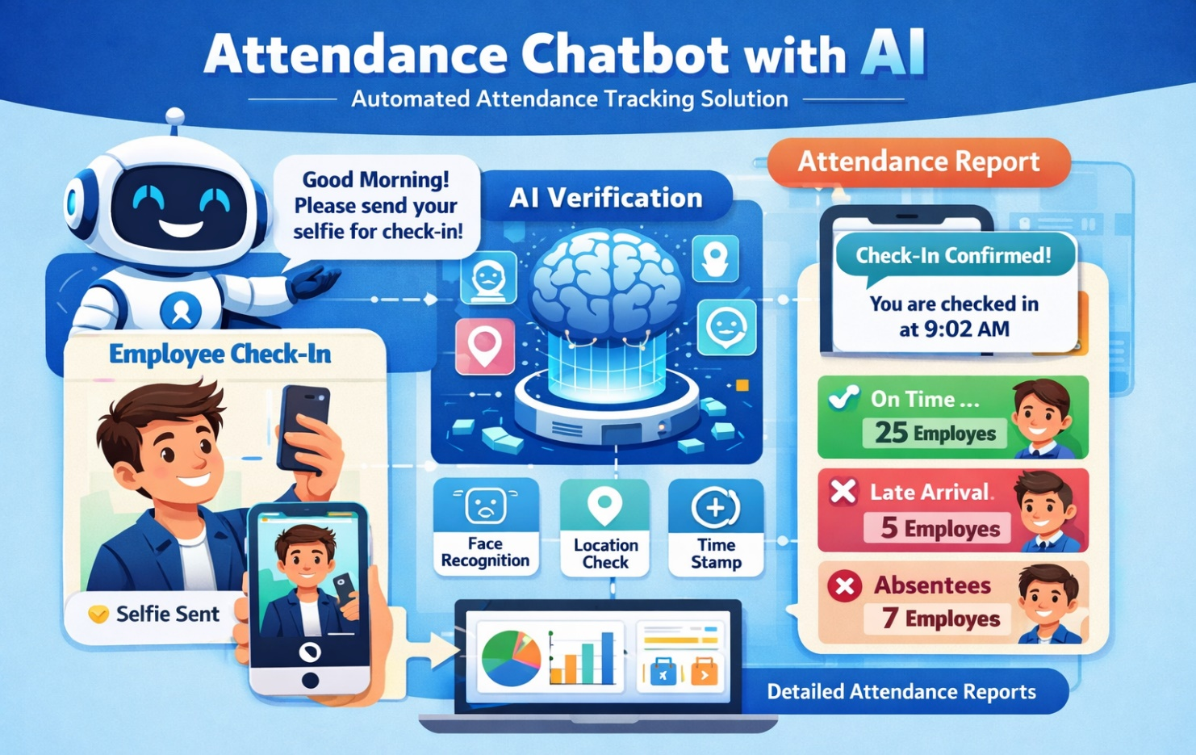
PROBLEM STATEMENT
High Manual Latency
Scalability Issues
Data Fragmentation
Inconsistent Record Keeping
Lack of Historical Continuity
Linguistic Ambiguity
Multilingual Constraints
Handling Typos
Message Overload
Duplicate Entry Management
Timestamp Manipulation
Lack of Biometric/Identity Proof
Context Blindness

Slide 4
PROPOSED SOLUTION
Voice-Enabled Attendance (Optional):Supports voice commands for hands-free attendance marking.
Multi-Platform Accessibility: Chat box works on web, mobile apps, Microsoft Teams, WhatsApp, or internal portals.
Fraud & Proxy Detection:AI detects unusual patterns such as repeated logins from different locations.
Location / IP-Based Attendance: Attendance can be restricted to authorized locations using GPS or IP verification.
Integration with Existing Systems : Seamlessly integrates with HRMS, ERP, LMS, or payroll systems.
AI-Based Validation Rules : AI validates time, location, and user identity before marking attendance.
User Authentication & Verification : Secure login using employee/student ID, OTP, or biometric integration to prevent proxy attendance.

Slide 5
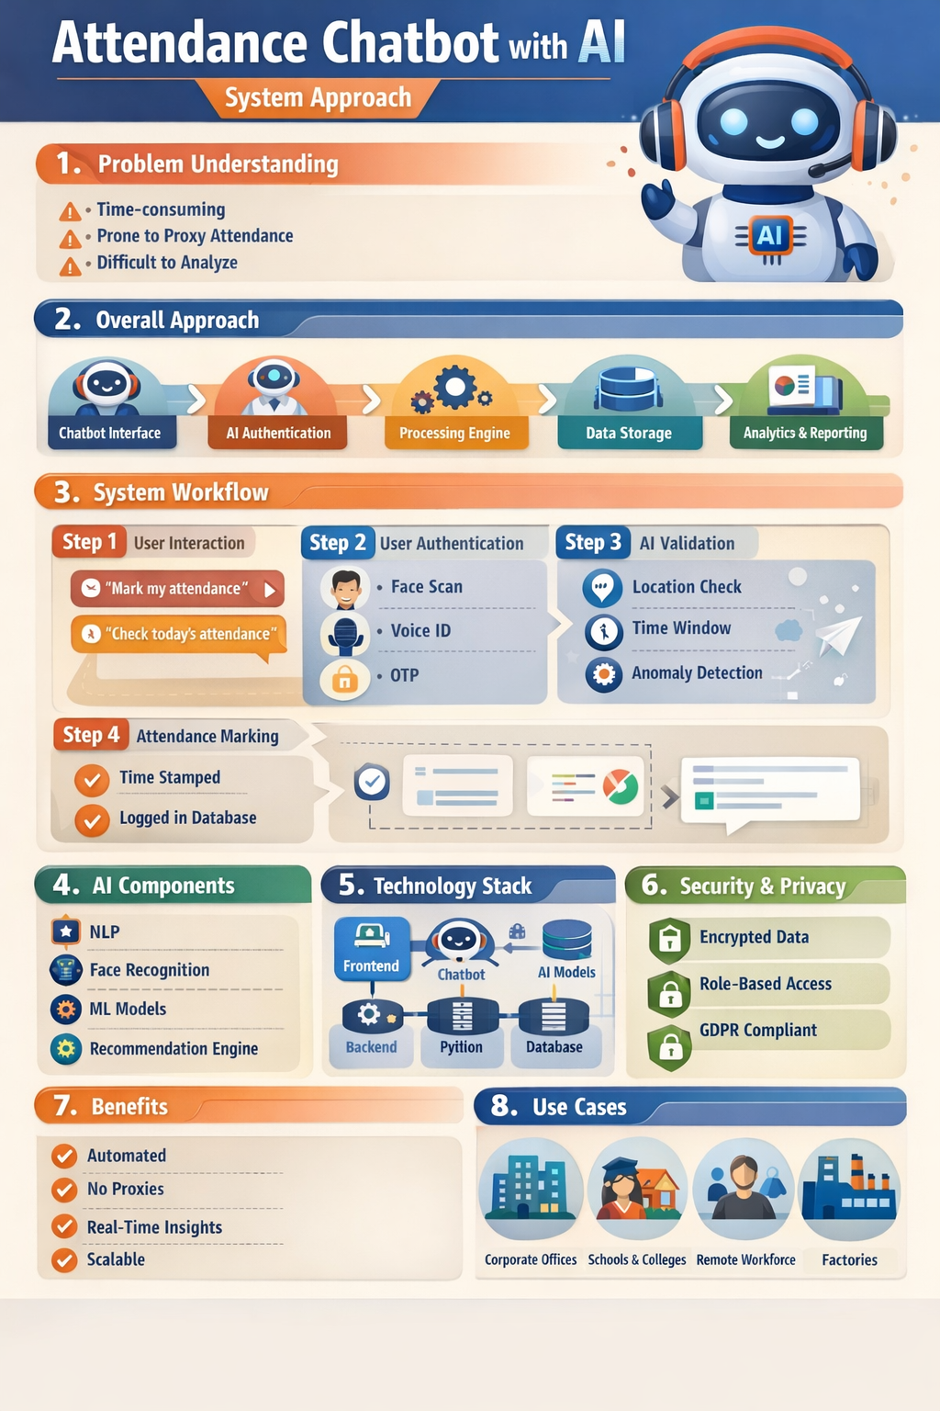
SYSTEM APPROACH
Python Libraries:
Streamlit – Chat-based user interface
Flask / FastAPI – Backend API development
NLTK – Natural language processing
spaCy – Intent recognition and NLP tasks
Transformers – Advanced AI models
Pandas – Data handling and analytics
NumPy – Numerical operations
SQLAlchemy – Database ORM
python-docx – Report generation
WeasyPrint – PDF report creation
SOFTWARE COMPONENTS
Chatbot Interface Software
AI/NLP Engine
Attendance Processing Software
Database Management System

Slide 6
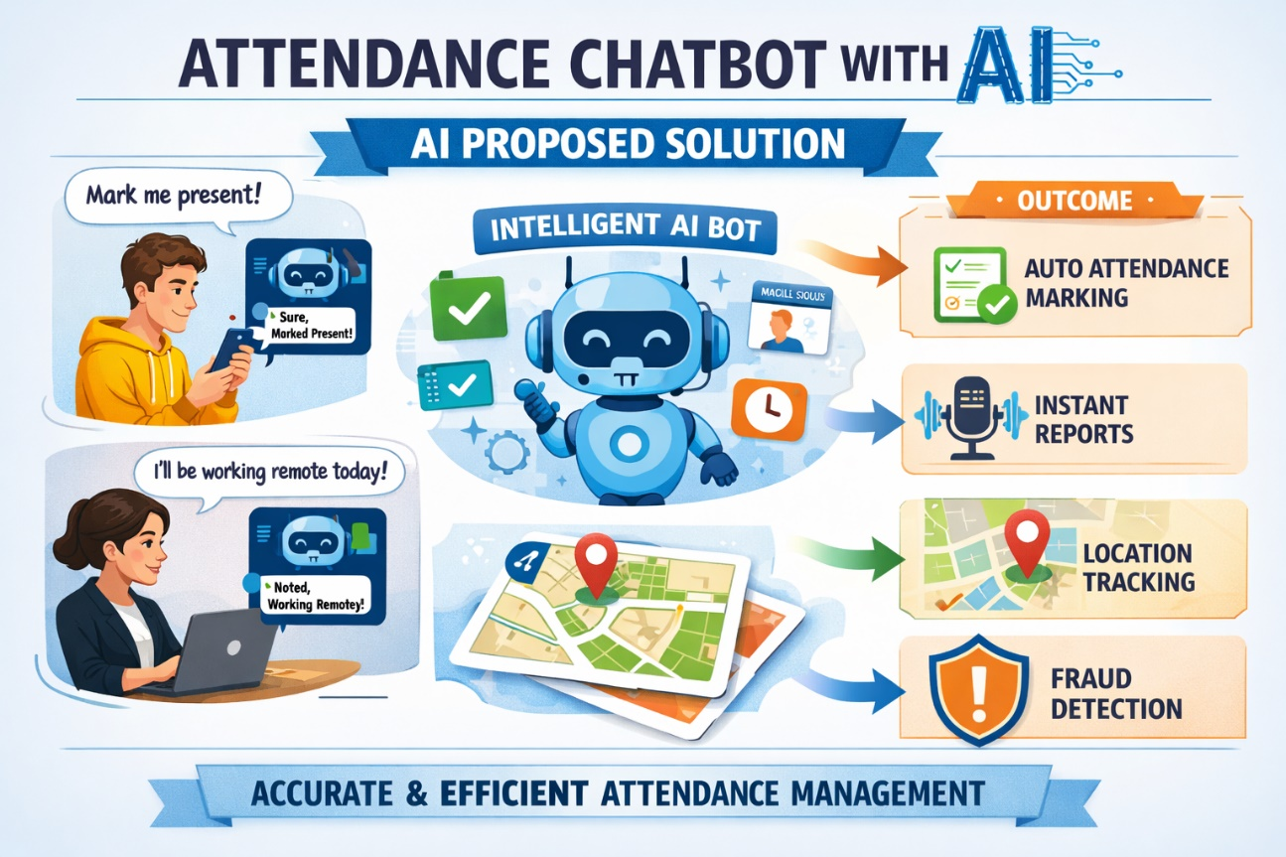
PROPOSED SOLUTION
Multimodal Verification (Face & Voice)
Conversational NLP Clock-In
Geofencing & GPS Intelligence
Predictive Burnout & Wellness Alerts
Instant Leave & Balance Queries
Smart Anomaly Detection
Generative Image "Site Reports“
Real-Time Manager Dashboards
Multi-Language & Global Compliance
Instant PTO Balance Queries
Smart Reminders
Kiosk Mode

Slide 7
TOOLS & TECHNOLOGIES
Programming Language:
Python, JavaScript
Frontend & UI:
HTML5, CSS3, JavaScript
Backend / AI Engine:
FastAPI / Flask
Speech-to-Text API (optional)
Document Processing:
Python-docx
Pandas
Environment Management:
python-dotenv (.env file for API key security
Version Control:
Git and GitHub
Deployment :
Streamlit Cloud

Slide 8
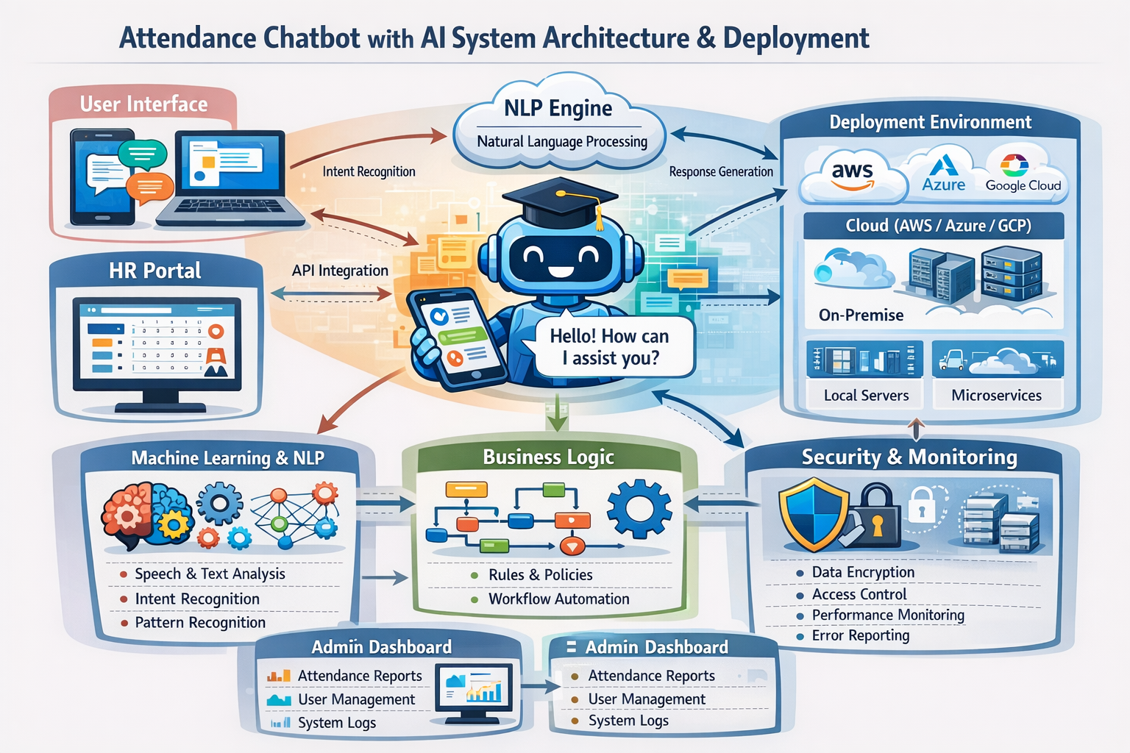
SYSTEM ARCHITECT & DEPLOYMENT

Slide 9
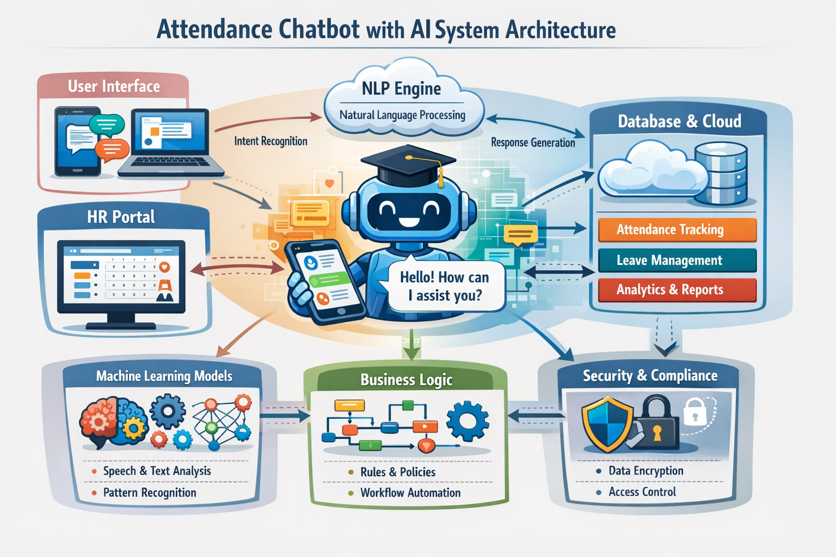
System Architecture

Slide 10
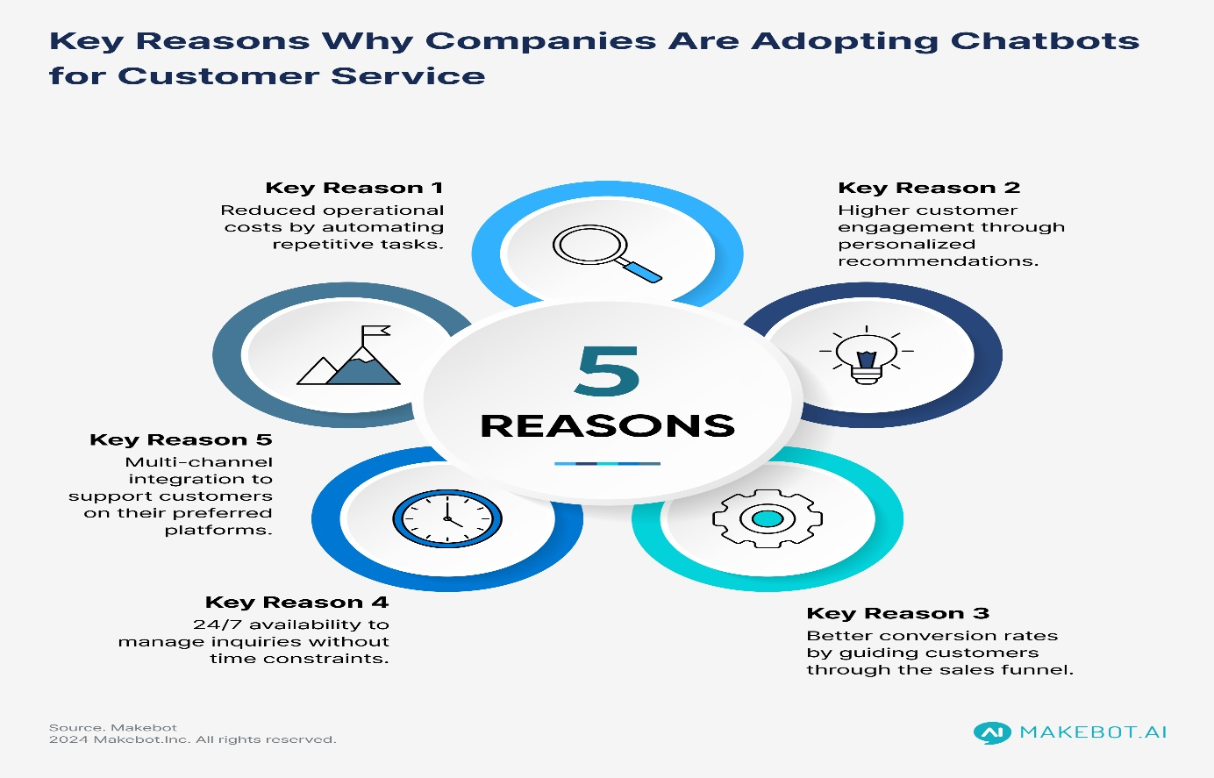
ADVANTAGES
Paperless system
Encourages digital transformation.
Improves discipline and punctuality.
Face recognition integration
Voice-based attendance marking
Geo-fencing for location-based validation
Self-improving chatbot intelligence.
Supports web and mobile platforms.
Low infrastructure cost
Cloud-based access from anywhere.
Generates real-time attendance reports.

Slide 11
RESULTS
Chat-based interface improved user engagement.
Users required minimal training to use the system.
The AI attendance chatbox successfully automated the attendance marking process.
Unauthorized or duplicate attendance entries were automatically detected and blocked.
Real-time attendance updates were reflected instantly in the database.
Manual attendance errors were reduced significantly through AI validation
Students/employees could mark attendance using natural language chat interaction.
Attendance records became more accurate and consistent
Real-time attendance updates were reflected instantly in the database.
Improved data reliability for audits and reviews.
Real-time analytics improved monitoring and control.
Compliance with institutional attendance policies was ensured.
Compliance with institutional attendance policies was ensured.

Slide 12
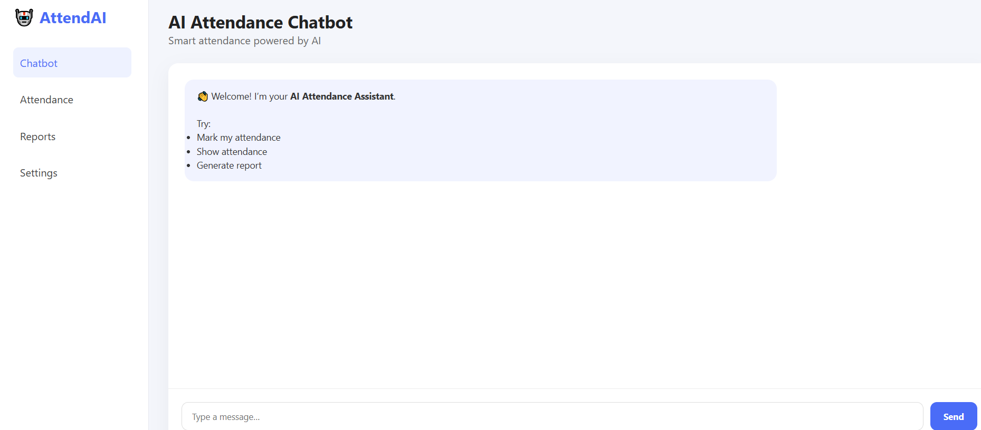
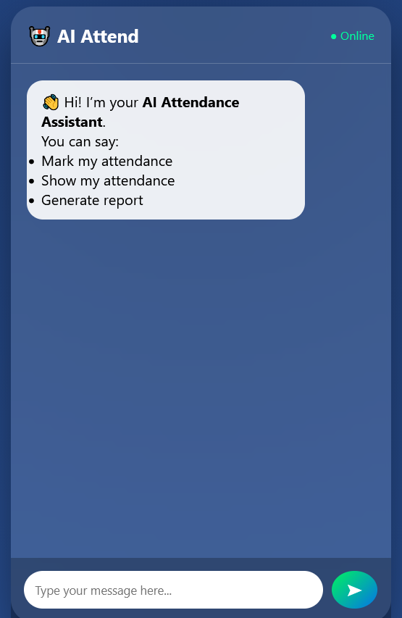
RESULTS

Slide 13
CONCLUSION
The AI-based Attendance Chat box provides a smart and automated approach to attendance management.
AI-driven insights enable better monitoring and performance evaluation.
Overall, the Attendance Chat box with AI is a future-ready digital solution that enhances efficiency and reliability in attendance systems.
The AI-based Attendance Chatbox provides a smart and automated approach to attendance management
It minimizes manual work and paperwork, reducing operational overhead.
A conversational chat interface makes attendance marking simple and user-friendly
Overall, the Attendance Chatbox with AI is a future-ready digital solution that enhances efficiency and reliability in attendance systems.
Secure authentication helps protect data integrity and privacy.
The system ensures higher accuracy by eliminating human errors and duplication.

Slide 14
FUTURE SCOPE
Advanced AI & Deep Learning Integration
Multimodal Attendance Systems
Integration with Smart Devices & IoT
Mobile & Wearable Support
Predictive Analytics & AI Insights
Smart Campus & Smart Office Automation
Blockchain-Based Attendance Records
Multilingual & Voice-Enabled Chatbots
Enhanced Security & Privacy
Cloud-Native & Scalable Deployment
Integration with AR/VR & Metaverse
Compliance, Auditing & Legal Use
The Attendance Chatbox with AI will evolve into a fully autonomous, intelligent workforce and academic management system, reducing manual effort, eliminating fraud, and enabling data-driven decision-making.

Slide 15
GITHUB LINK
GITHUB LINK:https://github.com/netivenkatkumar/ASAP-4-WEEK-NAME-ATTEDANCE-CHATBOX-AI.git
Deployment Link: file:///C:/Users/RAVINDRA/Desktop/ASAP_Attedance%20Chat%20box%20With%20AI/Attedance%20Chatbox%20With%20AI/Index.html
file:///C:/Users/RAVINDRA/Desktop/ASAP_Attedance%20Chat%20box%20With%20AI/Attedance%20Chatbox%20With%20AI/Attedance%20Chatbox%20With%20AI/Index.html

Slide 16
REFERENCES
Kaggle, dataset:
http://www.kaggle.com/datasets/studocu/studocu-employee-chat-AI/data
Streamlit Documentation, Developing and Deploying Data Apps. https://docs.streamlit.io/
Streamlit Community Cloud, Application Deployment Guide. https://docs.streamlit.io/deploy/streamlit-community-cloud

Slide 17

Attendance Chat With AI

